Slide 1
Crossing the entrepreneurial Rubicon - Formation of entrepreneurial intention in higher education
Richard Blaese, PhD-student
Prof. Dr. Pietro Morandi
Prof. Dr. Brigitte Liebig

Slide 2
Content
1-- Introduction
2-- Theoretical background
3-- Research question / hypotheses
4-- Method / sample
5-- Results
6-- Discussion and implication

Slide 3
INTRODUCTION
Third Mission includes the commercialization and promotion of academic entrepreneurship activities focusing on the scientific staff (Rasmussen et al. 2006, Bygrave & Minniti, 2000; Etzkowitz, 1983, Kirby et al 2012).
The institutional context in which researchers are embedded could either stimulate them or discourage them from becoming entrepreneurs (Huyghe & Knockaert, 2015).
Academic entrepreneurship is considered as an important economic driver (Ping 1980;OECD 2003) and refers to the creation of spin-offs, based on intellectual properties (IP) developed at universities.
RESEARCH GAP
The interplay between entrepreneurial institutional mechanisms (formal and informal conditions) and entrepreneurial decisions among researchers are hardly investigated (Miranda, 2017,Hmieleski & Powell, 2018).
The transition from entrepreneurial intentions to entrepreneurial action and thus the change of specific needs of support provided by universities were not taken into account in any empirical study on the effects of entrepreneurial framework conditions.

Slide 4
THEORETICAL BACKGROUND I
Theory of planned behavior (Ajzen, 1991)
Attitudes towards entrepreneurship (AT)
Subjective norms (SN)
Perceived behavioral control (PBC)
Entrepreneurial Intention
MINDSET THEORY OF ACTION PHASE (Gollwitzer und Brandstätter 1997)
Deliberating phase
“ Aspiring entrepreneurs”
Implementation phase
“Nascent entrepreneurs”
Potential founders in the deliberating (Pre-Rubicon) phase usually show general/abstract needs, while those in the implementation
(Post-Rubicon) phase tend to show focused and precise
needs, based on implementation issues.
(Delanoë-Gueguen & Fayolle, 2018)
Deliberative mindset
Implemental mindset
Entr. Intention
Implementation. Intention
Spin-off/Start-up
Feasibility desirability attitudes
Start-up/Spin-off
Directed gestation
actions
Rubicon
crossing
Aspiring entrepreneur
Nascent entrepreneur
New entrepreneur
A Rubicon Model of Entrepreneurial Action Phases. Adapted from Delanoë-Gueguen & Fayolle (2018), p.5

Slide 5
THE ENTREPRENEURIAL UNIVERSITY – FORMAL AND INFORMAL CONDITIONS
Kirby et al, 2012, used the institutional approach of North (1990/2005) and defined formal and informal factors that determine the development of an entrepreneurial university.
Role models (IC)
.
Positive effect on researchers' intentions to start their own businesses (Prodan and Drnovsek, 2010; Huyghe and Knockaert, 2015).
Entrepreneurial support (FC)
Reward system (IC)
Entrepreneurial support has a positive
impact on researchers‘ PBC
(Fernández-Pérez, Alonso-Galicia, Rodríquez-Ariza, &
del Mar Fuentes-Fuentes, 2015).
Financial and social rewards have a positive impact on researchers' spin-off intentions (Renault, 2006).

Slide 6
RESEARCH QUESTIONS & HYPOTHESIS
PART I – (How) Does the TPB-predictors continue to be indicators / predictors of ent. intention in an extended spin-up process (Pre - vs. Post-Rubicon)?
H1: PBC has a significant positive effect on entrepreneurial intentions. (EI) a) Pre-and b) Post-Rubicon.
H2: Attitudes towards entrepreneurship have a significant positive effect on EI. a) Pre- and b) Post-Rubicon.
H3. Subjective norms have a significant positive effect on EI. a) Pre- and b) Post-Rubicon.
PART II – Impact of higher education institutions on entrepreneurial behavior- According to the MINDSET THEORY OF ACTION PHASE (Gollwitzer and Brandstätter, 1997)
Informal conditions
H4: Role models have a significant positive effect on attitudes towards entrepreneurship. a) Pre- and b) Post-Rubicon
H5: Role models have a significant positive effect on PBC. a) Pre- and b) Post-Rubicon.
H6: Entrepreneurial rewards have a positive effect on entrepreneurial intentions. a) Pre- and b) Post-Rubicon.
H7: Entrepreneurial rewards have a positive influence on the subjective norms. a) Pre- and b) Post-Rubicon.
Formal conditions
H8: Perceived entrepreneurial support has a significant positive effect on PBC. (Post-Rubicon).

Slide 7
METHOD
Online survey for scientists at Swiss universities of applied sciences from January to March 2019. (french, german, english) (n = 2,377)
Scientists with founding experience (Start-up/Spin-off) were filtered out of the sample (n = 537)
Conducting a Brocken-Stick-Regression. This allows participants to be assigned into two groups according to their ent. engagement (Pre-Post-Rubicon).
To test the hypotheses, a structural equation model with the two groups was developed.
Formal and informal conditions
Perceived institutional rewards (of the university), 1 Item
Role models,1 Item
Perceived entrepreneurial support (PES), 6 Items, (α=.94 )
(e.g. Coaching offers, Financing of prototypes,..etc.)
Entrepreneurial intention (EI), 3 Items, (α = .87)
Subjective norm (SN), 3 Items (α = .84)
Perceived behavioral control (PBC), 4 Items (α = .91)
Attitudes towards entrepreneurship (EA), 3 Items (α = .90)
Ent. engagement (Gestations actions (GA)*,13 Items,*Reynolds, P. D. (2000).
(e.g. “Preparation of a business plan; Full-time work on this project; etc..”)

Slide 8
TOTAL SAMPLE
 | Social Work, Economy, Health, Arts & Design (n = 1 208) | STEM (n = 1 169) | Total (n = 2 377)
Start-up / Spin-off
Founded | 275 (17 %) | 262 (22 %) | 537 (23 %)
The company is active | 147 (53 %) | 159 (60 %) | 306 (56 %)
Already thought of founding a company | 267 (28 %) | 375 (41 %) | 642 (34.8 %)
Intention to become an entrepreneur
Mean (SD) | 2.48 (1.50) | 3.17 (1.67) | 2.83 (1.62)
Median [Min, Max] | 2.00 [1.00, 7.00] | 3.00 [1.00, 7.00] | 2.67 [1.00, 7.00]
Gender
males | 810 | 1 140 | 1 950
female | 809 | 345 | 1 154
Personnel category
Lecturer / Professor with leadership responsibility | 387 | 344 | 781
Other lecturers without leadership responsibility | 549 | 250 | 857
Research assistant | 446 | 689 | 1209
Board of Directors, admin & technical staff | 95 | 74 | 179

Slide 9
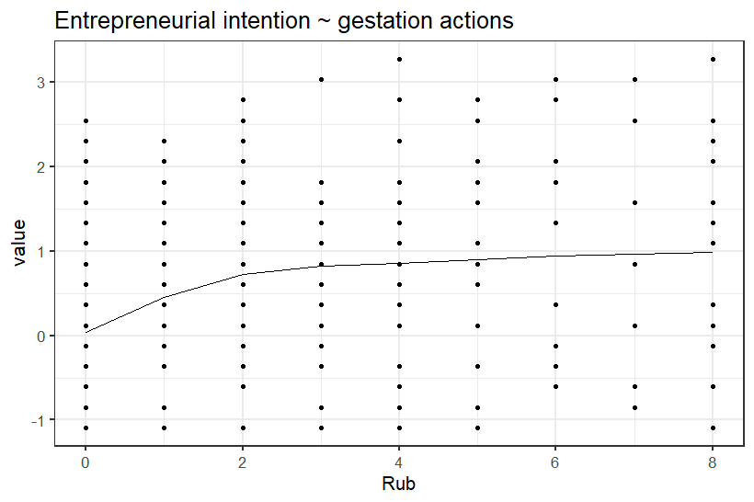
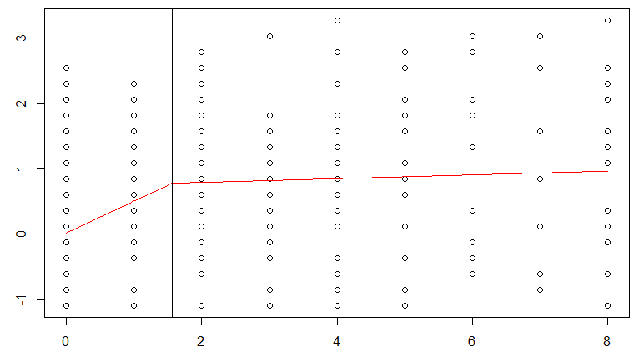
RESULTS I – BROCKEN STICK REGRESSION in «segmented» & «SiZer» version 0.1-5
Calculates predicted values from a piecewise linear object and fits regression models with segmented relationships
between the response and one or more explanatory variables.
Entrepreneurial Intention
Value Pre Post
Frequency N=538 N=202
Proportion 73% 27%
$$\sum{Gestation actions} (GA Ent.Engagement)$$

Slide 10
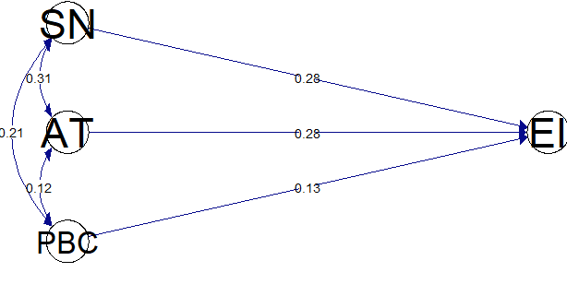
RESULTS II – TESTING HYPOTHESIS
Pre-Rubicon (n=272)
Post-Rubicon (n=158)
***
***
*
***
***
***
***
*
***
***
$R^{2}=.3$1
$R^{2}=.3$0
n.s
*
***
***
***
#Controlled for gender,
personal category, discipline
$X^{2}$(df) = 224.3(141)
CFI = .97
TLI = .96
RMSEA = .05
*p<0.05, ** p<0.01, ***p<0.001
#Calulated with «Lavaan»
#Plotted with «semPaths»
Notes:
Man unterscheidet hier globale Anpassungsmaße (z. B. -Wert, Goodness of Fit Index (GFI), Root Mean Square Error of Approximation (RMSEA)), inkrementelle Anpassungsmaße (z. B. Normed Fit Index (NFI) Tucker-Lewis Index (TLI), Comparative Fit Index (CFI)) sowie Maße der Sparsamkeit (z. B. Normed , Adjusted Goodness of Fit Index (AGFI)). Als Kriterien für gute Modellpassung wird gefordert: nicht signifikanter -Wert, GFI > ,95, RMSEA < ,05, NFI > ,95, TLI > ,95, CFI > ,95, Normed < 2, AGFI > ,9.

Slide 11
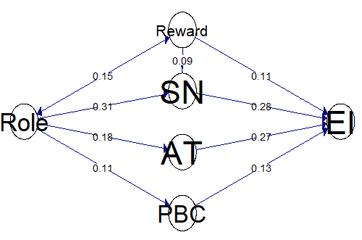
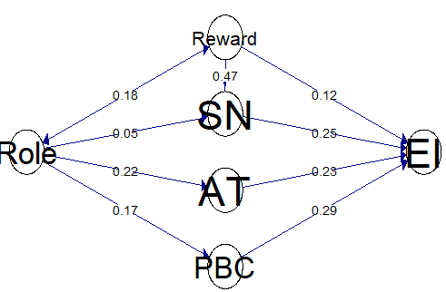
RESULTS III – TESTING HYPOTHESIS (Informal conditions)
Pre-Rubicon (n=240)
Post-Rubicon (n=138)
*
n.s.
*
***
*
*
***
$R^{2}=.$116
***
n.s.
***
$R^{2}=.$228
***
***
***
***
$R^{2}=.$28
$$R^{2}=.32$$
*
$R^{2}=.$033
*
*
$R^{2}=.$049
***
$R^{2}=.$012
$R^{2}=.$028
#Controlled for gender,
personal category, discipline
$X^{2}$(df) = 314(196)
CFI = .96
TLI = .95
RMSEA = .05
*p<0.05, ** p<0.01, ***p<0.001
#Calulated with «Lavaan»
#Plotted with «semPaths»

Slide 12
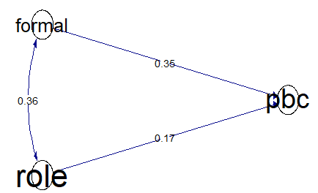
RESULTS IV – TESTING HYPOTHESIS (Formal conditions)
Pre-Rubicon (n=80)
Post-Rubicon (n=72)
***
***
$R^{2}=.$10
$R^{2}=.$24
#Controlled for gender,
personal category, discipline
$X^{2}$(df) = 118(120)
CFI = 1
TLI = .1
RMSEA = .00
*p<0.05, ** p<0.01, ***p<0.001
#Calulated with «Lavaan»
#Plotted with «semPaths»

Slide 13
DISCUSSION & IMPLICATION
Hypotheses 1) to 3) could be confirmed. The TPB predictors have a strong predictive power to explain entrepreneurial intentions both Pre-and Post-Rubicon.
Hypothesis 1) illustrates that PBC had a stronger influence on entrepreneurial intentions after crossing the Ent. Rubicon than in the Deliberative phase.
Hypotheses 4) and 5) could be confirmed. Thus, role models both Pre- and Post-Rubicon show a strong influence on PBC and attitudes toward entrepreneurship.
Hypotheses 6) and 7) were partially confirmed. Social and financial rewards do have a positive direct influence on entrepreneurial intentions. However, the indirect influence of rewards on social norms is only after crossing the Rubicon significant.
Hypothesis 8) could also be confirmed in a SEM. Thus, formal (concrete) support offers have a significant positive effect on PBC in the Implementation phase.
This contribution analyzes for the first time the importance of organizational-climatic conditions for academic spin-offs within universities before and after exceeding an Entrepreneurial Rubicon.
The MINDSET THEORY OF THE ACTION PHASE contributes significantly to the understanding of the academic founding process.
The results indicate the need for phase-specific support.

Slide 14
Thank you for your attention!
www.SP F.ch

Slide 15
References
Baum, J. R., Frese, M., & Baron, R. A. (2014). The psychology of entrepreneurship: Psychology Press.
Bechthold, L. A., & Rosendahl Huber, L. (Eds.) 2018. Yes, I can!–A Field Experiment on Female Role Model Effects in Entrepreneurship. : Vol. 2018: Academy of Management Briarcliff Manor, NY 10510.
Brandstätter, V., Heimbeck, D., Malzacher, J., & Frese, M. (2003). Goals need implementation intentions: The model of action phases tested in the applied setting of continuing education. European Journal of work and organizational psychology, 12(1), 37–59.
Delanoë‐Gueguen, S., & Fayolle, A. (2018). Crossing the entrepreneurial rubicon: A longitudinal investigation. Journal of Small Business Management.
Fernández-Pérez, V., Alonso-Galicia, P. E., Rodríquez-Ariza, L., & del Mar Fuentes-Fuentes, M. (2015). Professional and personal social networks: A bridge to entrepreneurship for academics? European Management Journal, 33(1), 37–47.
Gollwitzer, P. M., Heckhausen, H., & Ratajczak, H. (1990). From weighing to willing: Approaching a change decision through pre-or postdecisional mentation. Organizational Behavior and Human Decision Processes, 45(1), 41–65.
Hmieleski, K. M., & Powell, E. E. (2018). The psychological foundations of university science commercialization: A review of the literature and directions for future research. Academy of Management Perspectives, 32(1), 43–77.
Huyghe, A., & Knockaert, M. (2015). The influence of organizational culture and climate on entrepreneurial intentions among research scientists. The Journal of Technology Transfer, 40(1), 138–160.
Johnson, D., & Tierney, D. (2011). Crossing the Rubicon: The Perils of Committing to a Decision. Cambridge, MA: Belfer Center for Science and International Affairs, Harvard Kennedy School.
Kautonen, T., van Gelderen, M., & Fink, M. (2015). Robustness of the theory of planned behavior in predicting entrepreneurial intentions and actions. Entrepreneurship Theory and practice, 39(3), 655–674.
Miranda, F. J., Chamorro-Mera, A., & Rubio, S. (2017). Academic entrepreneurship in Spanish universities: An analysis of the determinants of entrepreneurial intention. European research on management and business economics, 23(2), 113–122.
Reynolds, P. D. (2005). Understanding business creation: Serendipity and scope in two decades of business creation studies. Small Business Economics, 24(4), 359–364.

